Slide 1

Electric Vehicle Sales by State in India
This dataset is valuable for analysts, data scientists, and researchers aiming to
understand electric vehicle (EV) adoption trends across India. It is versatile and ideal
for geographic market segmentation, trend analysis, and predictive modeling. By
offering insights into regional EV sales patterns, the dataset supports strategic
decision-making in market planning and infrastructure investment.
The data was meticulously scraped from the Clean Mobility Shift website, and then
thoroughly preprocessed to ensure accuracy and relevance. All null values have been
removed, and the dataset has been cleaned to prepare it for immediate use in
exploration, visualization, and analytical projects. It is particularly valuable for market
trend analysis, infrastructure planning, and policy development within the EV sector.
The dataset is provided in CSV format and is ready for analysis.

Slide 2
Steps Involved
1 . Data Collection: Load and inspect the dataset.
2. Data Preprocessing: Handle missing values, convert date formats, and perform feature engineering.
3. Exploratory Data Analysis (EDA): Visualize trends and relationships between variables.
4. Feature Engineering: Create new features from the date column and encode categorical variables.
5. Modeling: Build a regression model to predict EV sales.
6. Evaluation: Evaluate the model performance and interpret the results.
7. Visualization: Visualize the results and trends using graphs and charts.

Slide 3
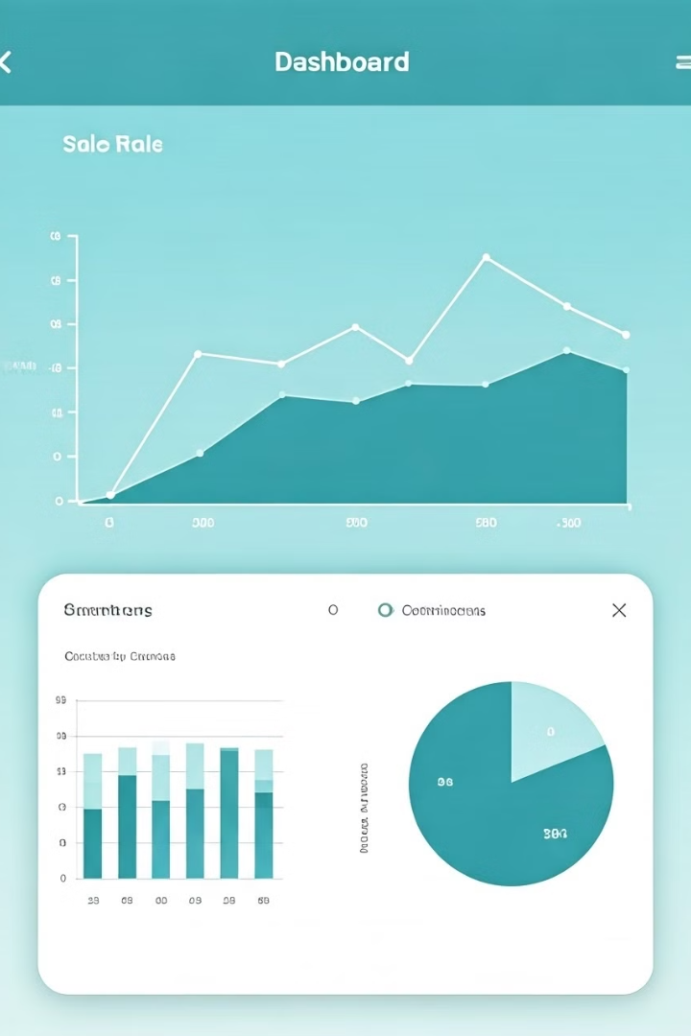
Exploratory Data Analysis (EDA)
Exploratory Data Analysis (EDA) is conducted to gain insights into the dataset. This includes visualizing the distribution of sales by category using box plots, examining sales trends over time by plotting total sales against the order date, and generating a correlation heatmap to understand the relationships between different variables.
These visualizations help in identifying patterns, outliers, and correlations that can inform feature selection and model building. The EDA process provides a comprehensive understanding of the data's characteristics and potential predictive variables.

Slide 4
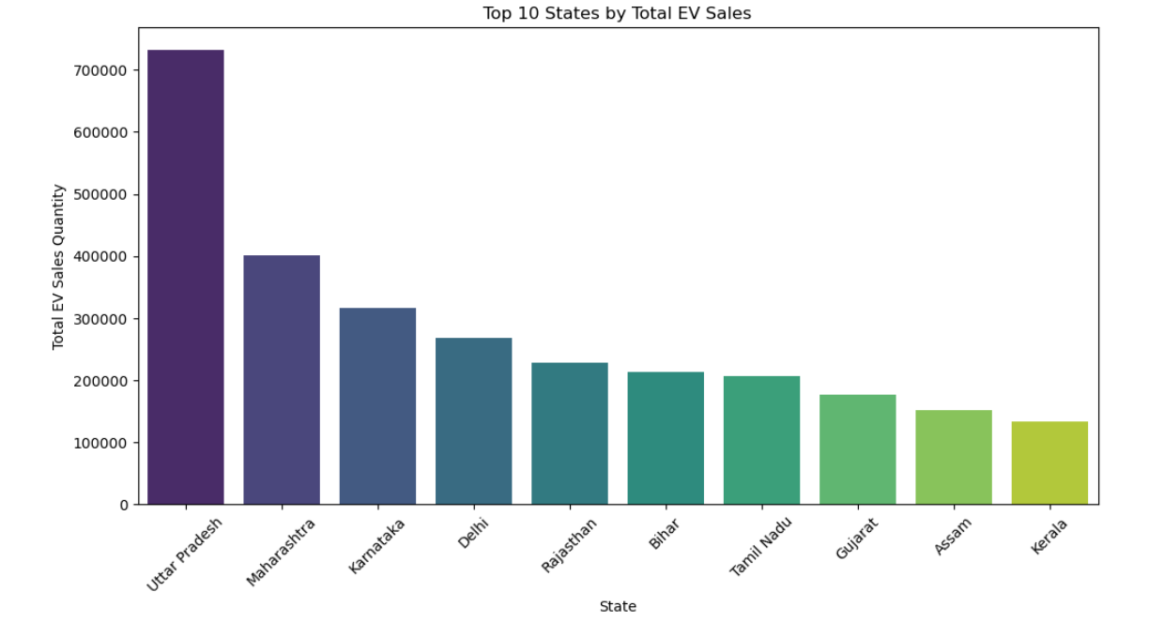
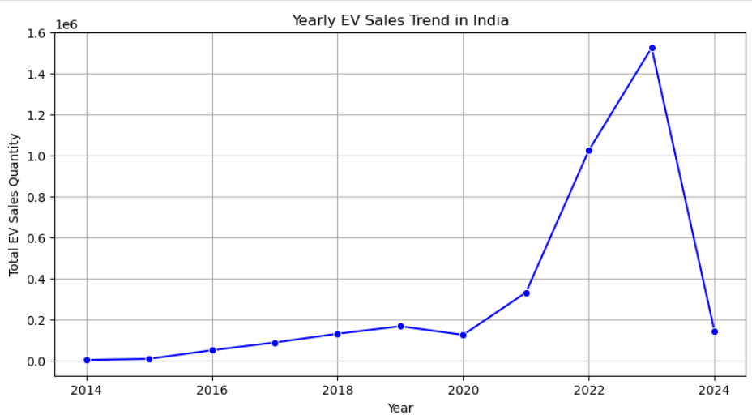

Slide 5
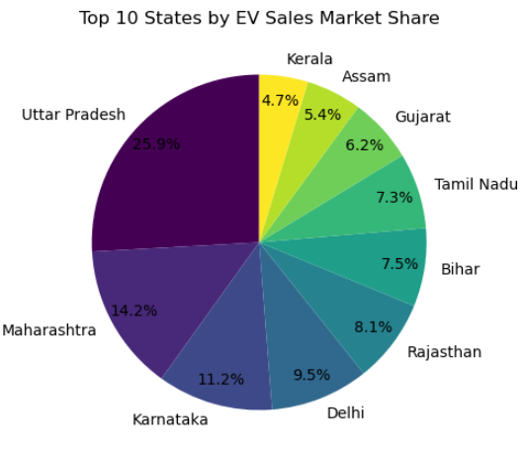
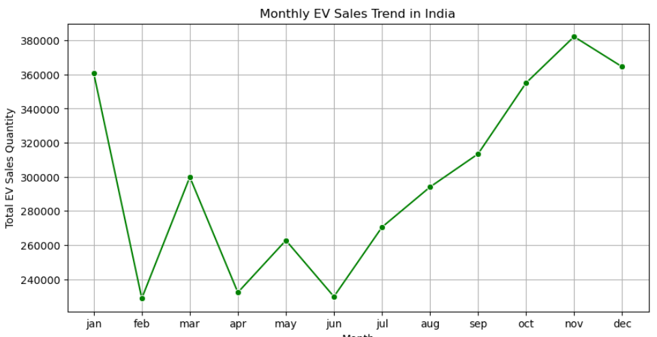

Slide 6
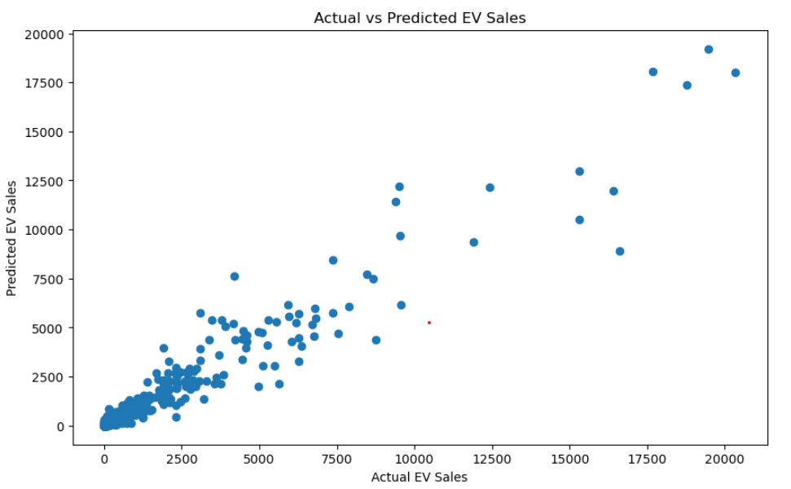
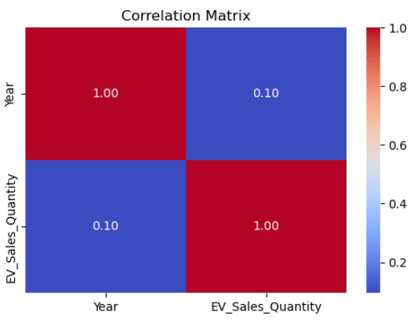

Slide 7
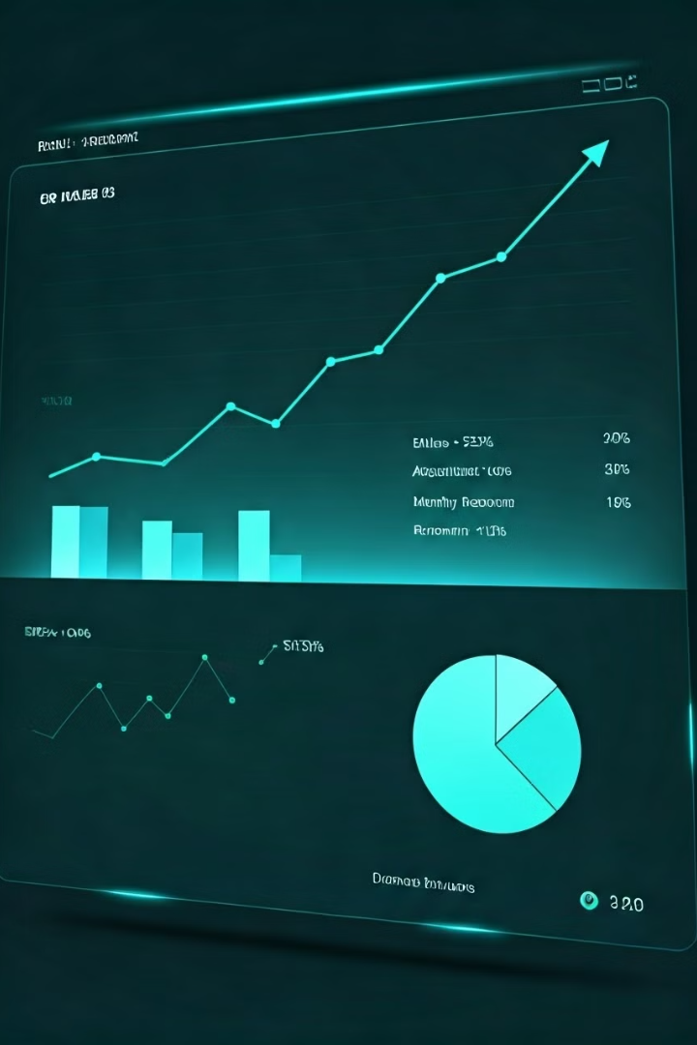
Conclusion
The analysis of EV sales in India shows a strong growth trend, with certain states leading in adoption. Two-wheeler and three-wheeler EVs dominate the market. Seasonal variations and policy impacts influence sales. Continuous growth suggests increasing EV acceptance, but infrastructure improvements are crucial for sustained expansion.

Slide 8
BUSINESS INSIGHTS
Dominant Category: 2-Wheelers lead sales (1.81M units).
Regional Focus: Top 5 states account for 2.37M sales (59% of total).
Growth Potential: 4W Personal vehicles show strong adoption (31K units).

